Slide 1
PCIE Boot Demo
Eric Ding
June 30, 2011

Slide 2
Agenda
Overview
PCIE initialization
PCIE boot example
Linux Host Loader
Demo

Slide 3
PCIE Initialization
Functions:
Initialize the PLL
Enable PCIE module
Configure PCIE registers
Monitor the magic address (0x87FFFC) for secondary boot.
Need to run on DSP first
Check the successful enumeration
local-ubuntu:~$ lspci –n
00:00.0 0600: 8086:2774
00:1b.0 0403: 8086:27d8 (rev 01)
….
00:1f.3 0c05: 8086:27da (rev 01)
01:00.0 0480: 104c:8888 (rev 01)
03:00.0 0200: 14e4:1677 (rev 01)

Slide 4
PCIE boot example
“Hello world” example under MCSDK
Convert the ELF out file into header file (data array) to be loaded by Linux host into DSP
View the results via UART (minicom on Linux)

Slide 5
PCIE Linux Host Loader Code
Mapping between PC memory and DSP memory
Configure the PCIE inbound address translation
Provide DSP memory read/write API:
Uint32 ReadDSPMemory(Uint32 coreNum, Uint32 DSPMemAddr, Uint32 *buffer, Uint32 length)
Uint32 WriteDSPMemory(Uint32 coreNum, Uint32 DSPMemAddr, Uint32 *buffer, Uint32 length)
Parse the boot example header array to load data into DSP
Write the boot entry address into the magic address on core 0 to jump start

Slide 6
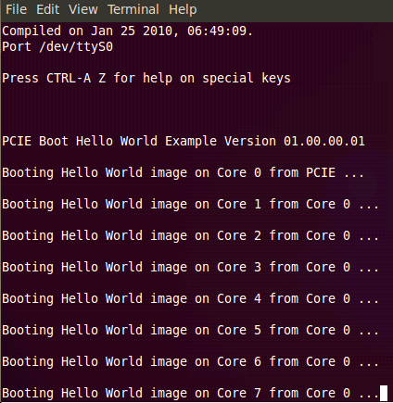
Set-up and demo
An AMC adaptor card, a TMS320C6678L EVM card, a Linux PC and a UART cable
Write the PCIE init code into NOR, set NOR boot
Compile the Linux host loader code and insert the module into kernel
Expected results:

